Slide 1
Big Budgets, Bigger Returns?
File created on: 5/3/26 9:22:27 PM CDT

Slide 2
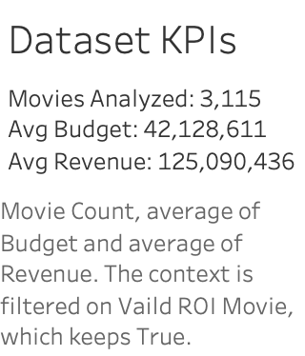

Slide 3


Slide 4
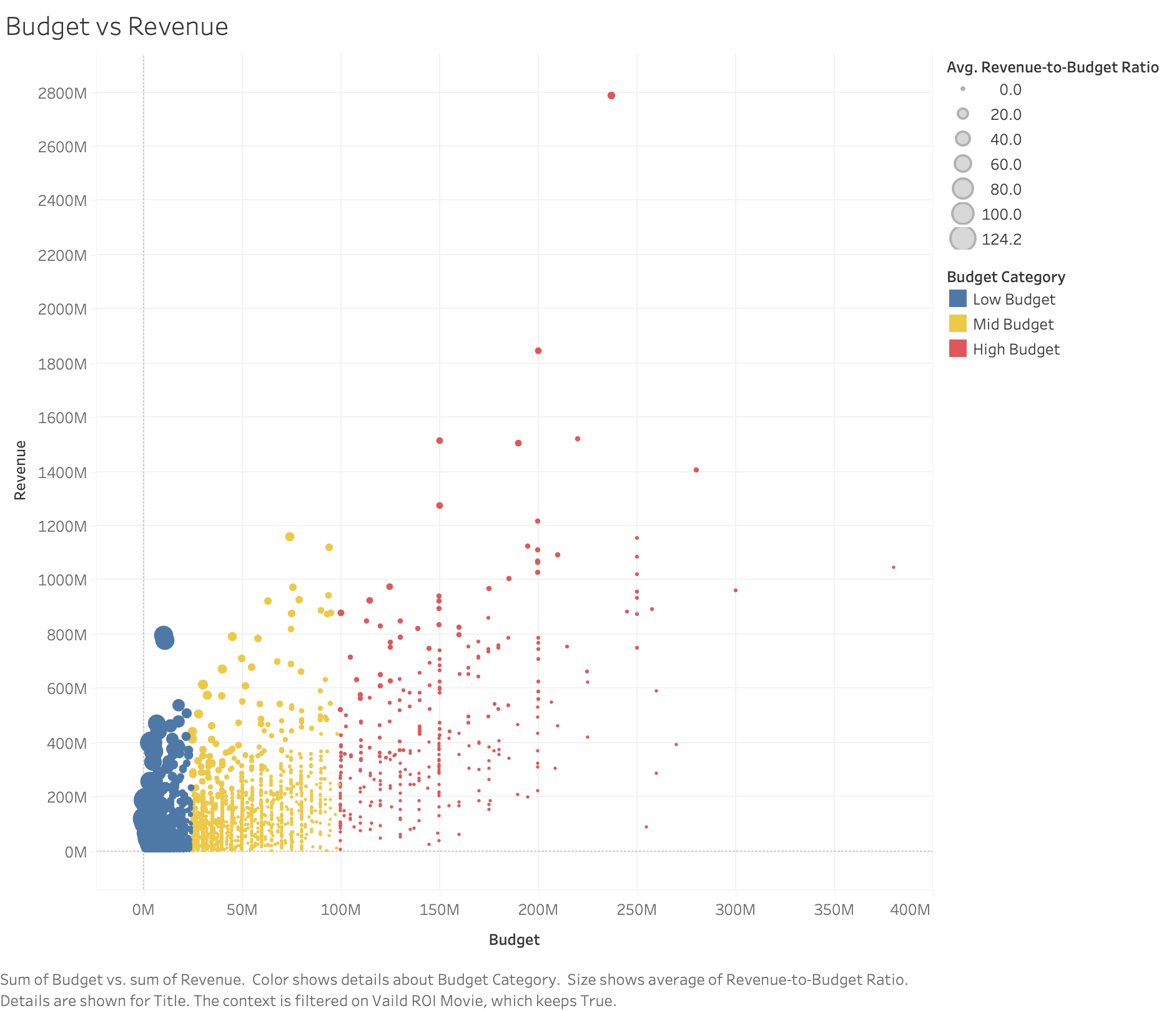

Slide 5
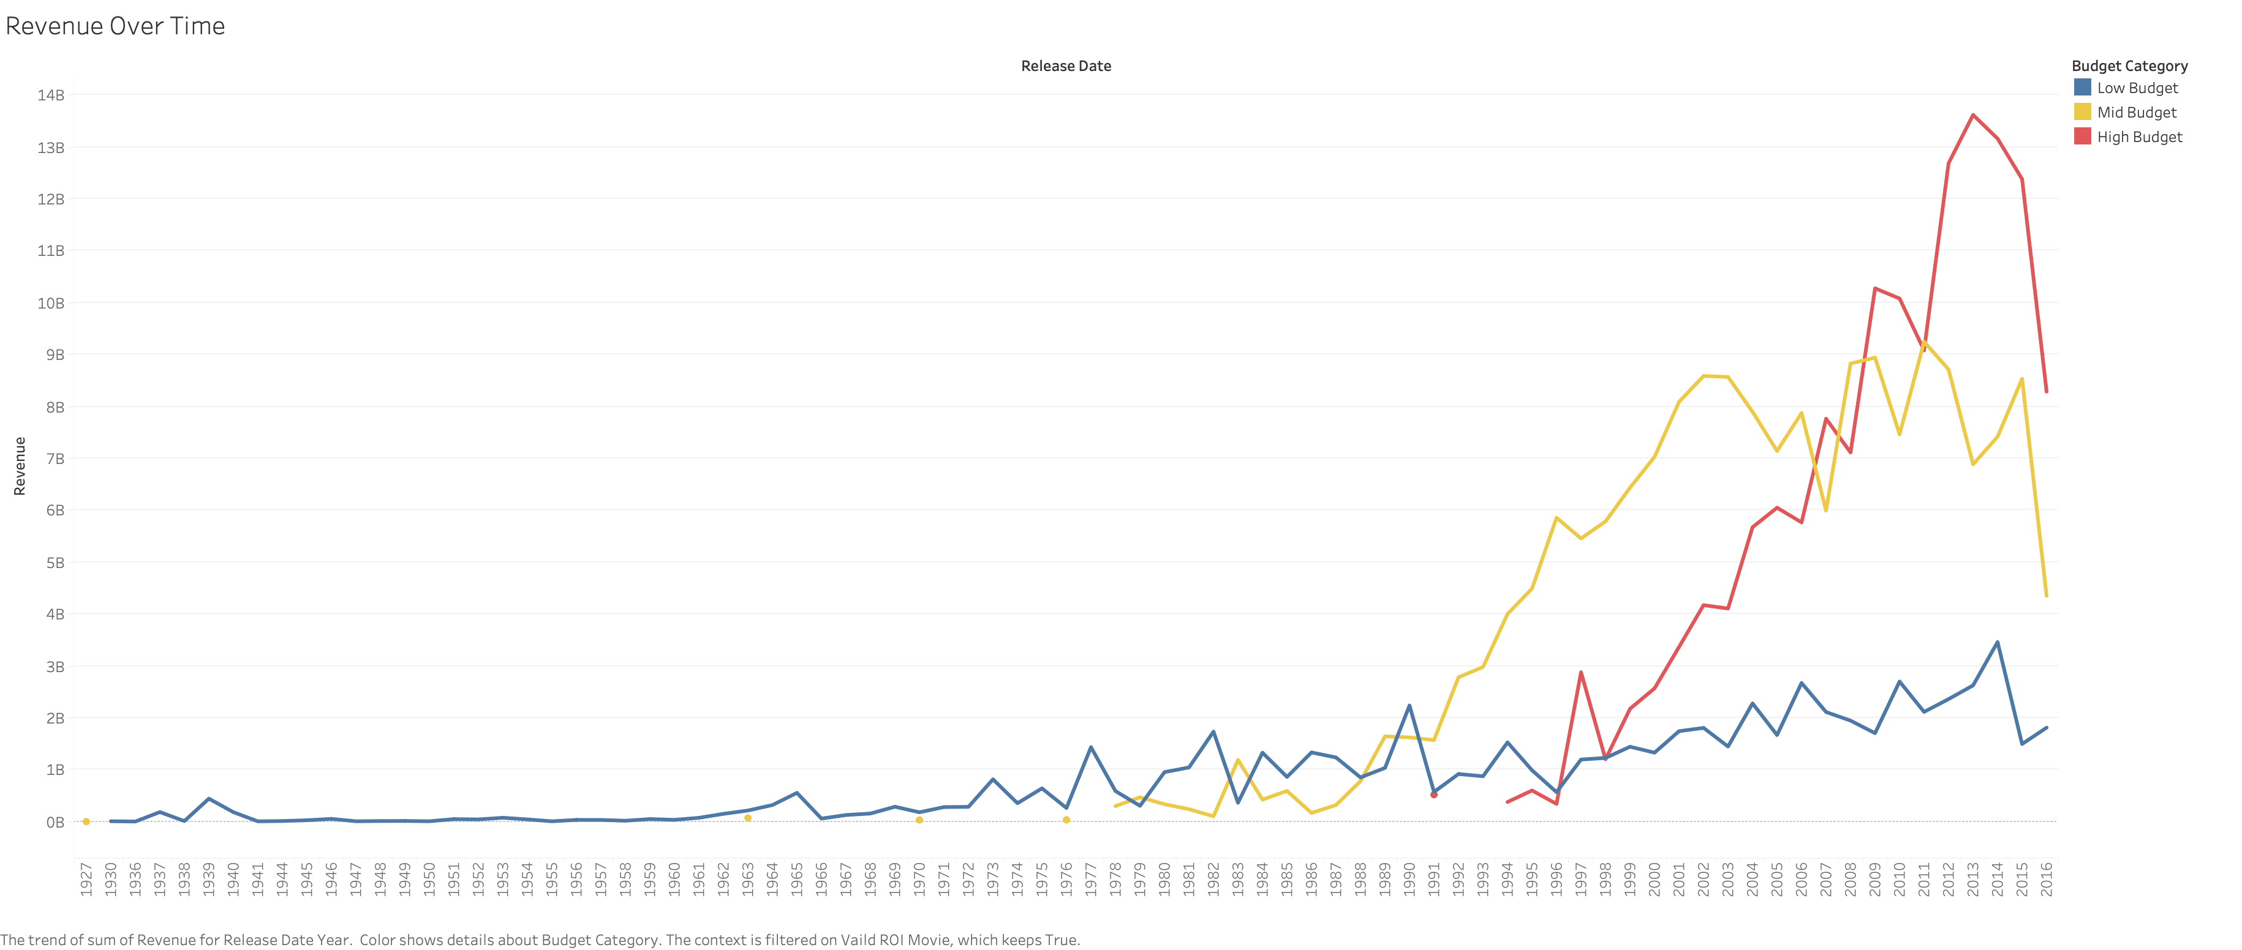

Slide 6


Slide 7


Slide 8
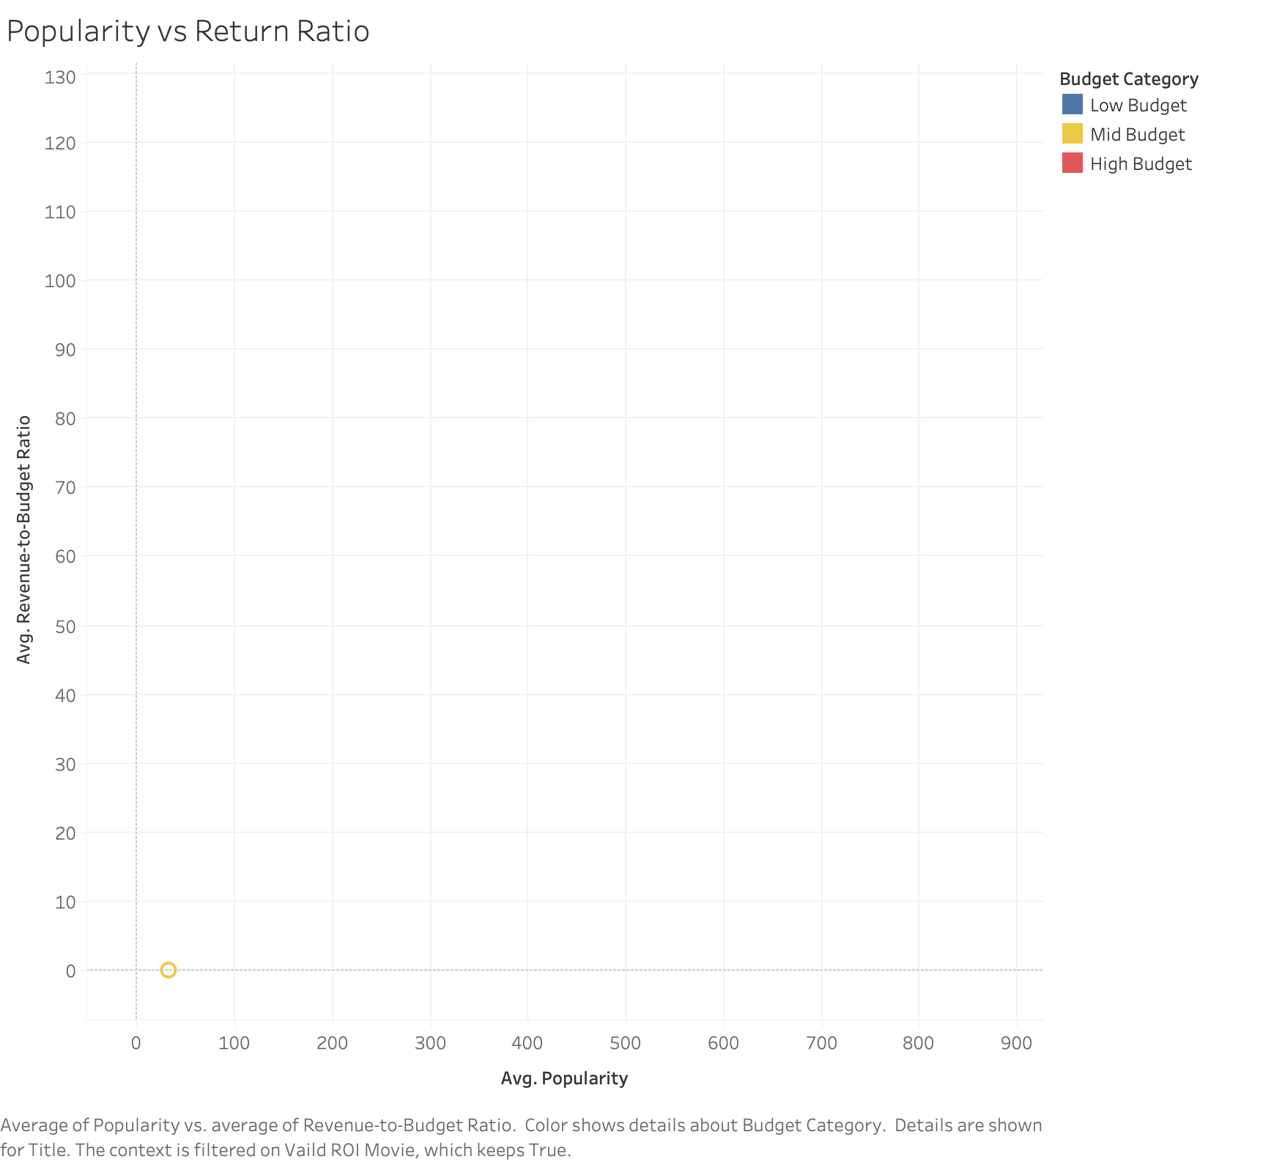

Slide 9
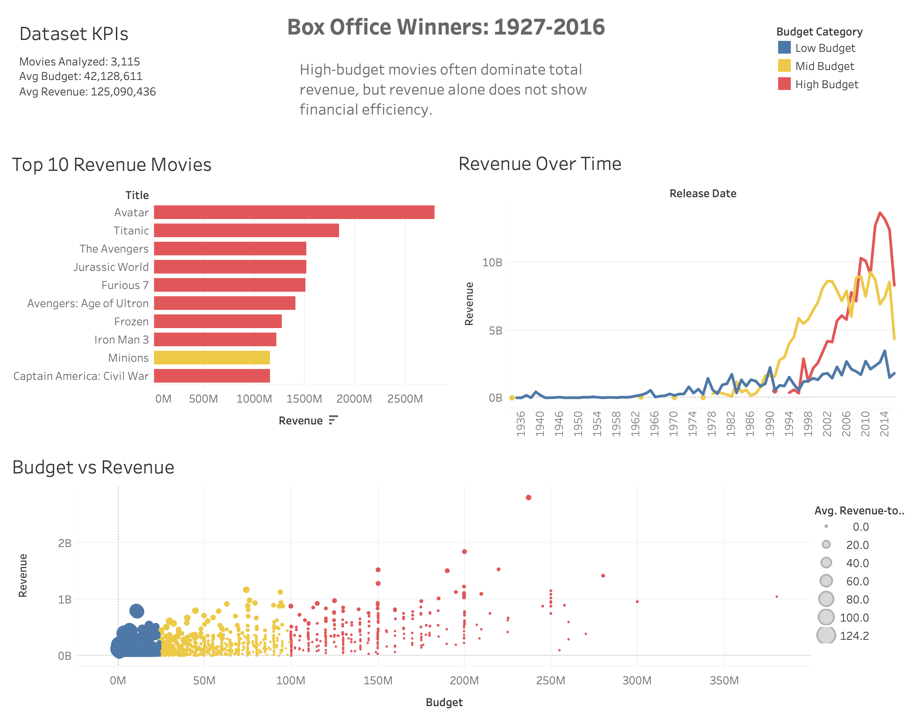

Slide 10
